Slide 1
Deep learning AI Chatbot
seq2seq with Attention

Slide 2
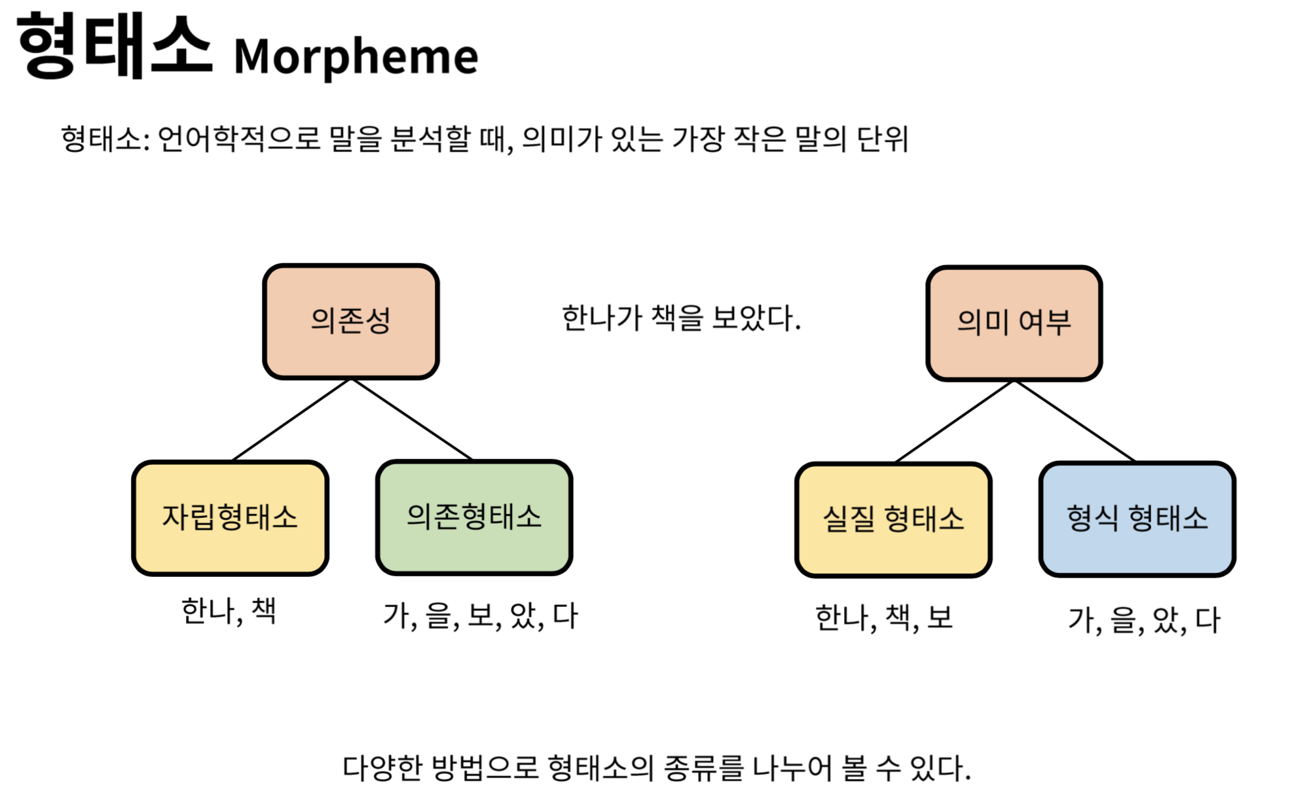
https://heung-bae-lee.github.io

Slide 3
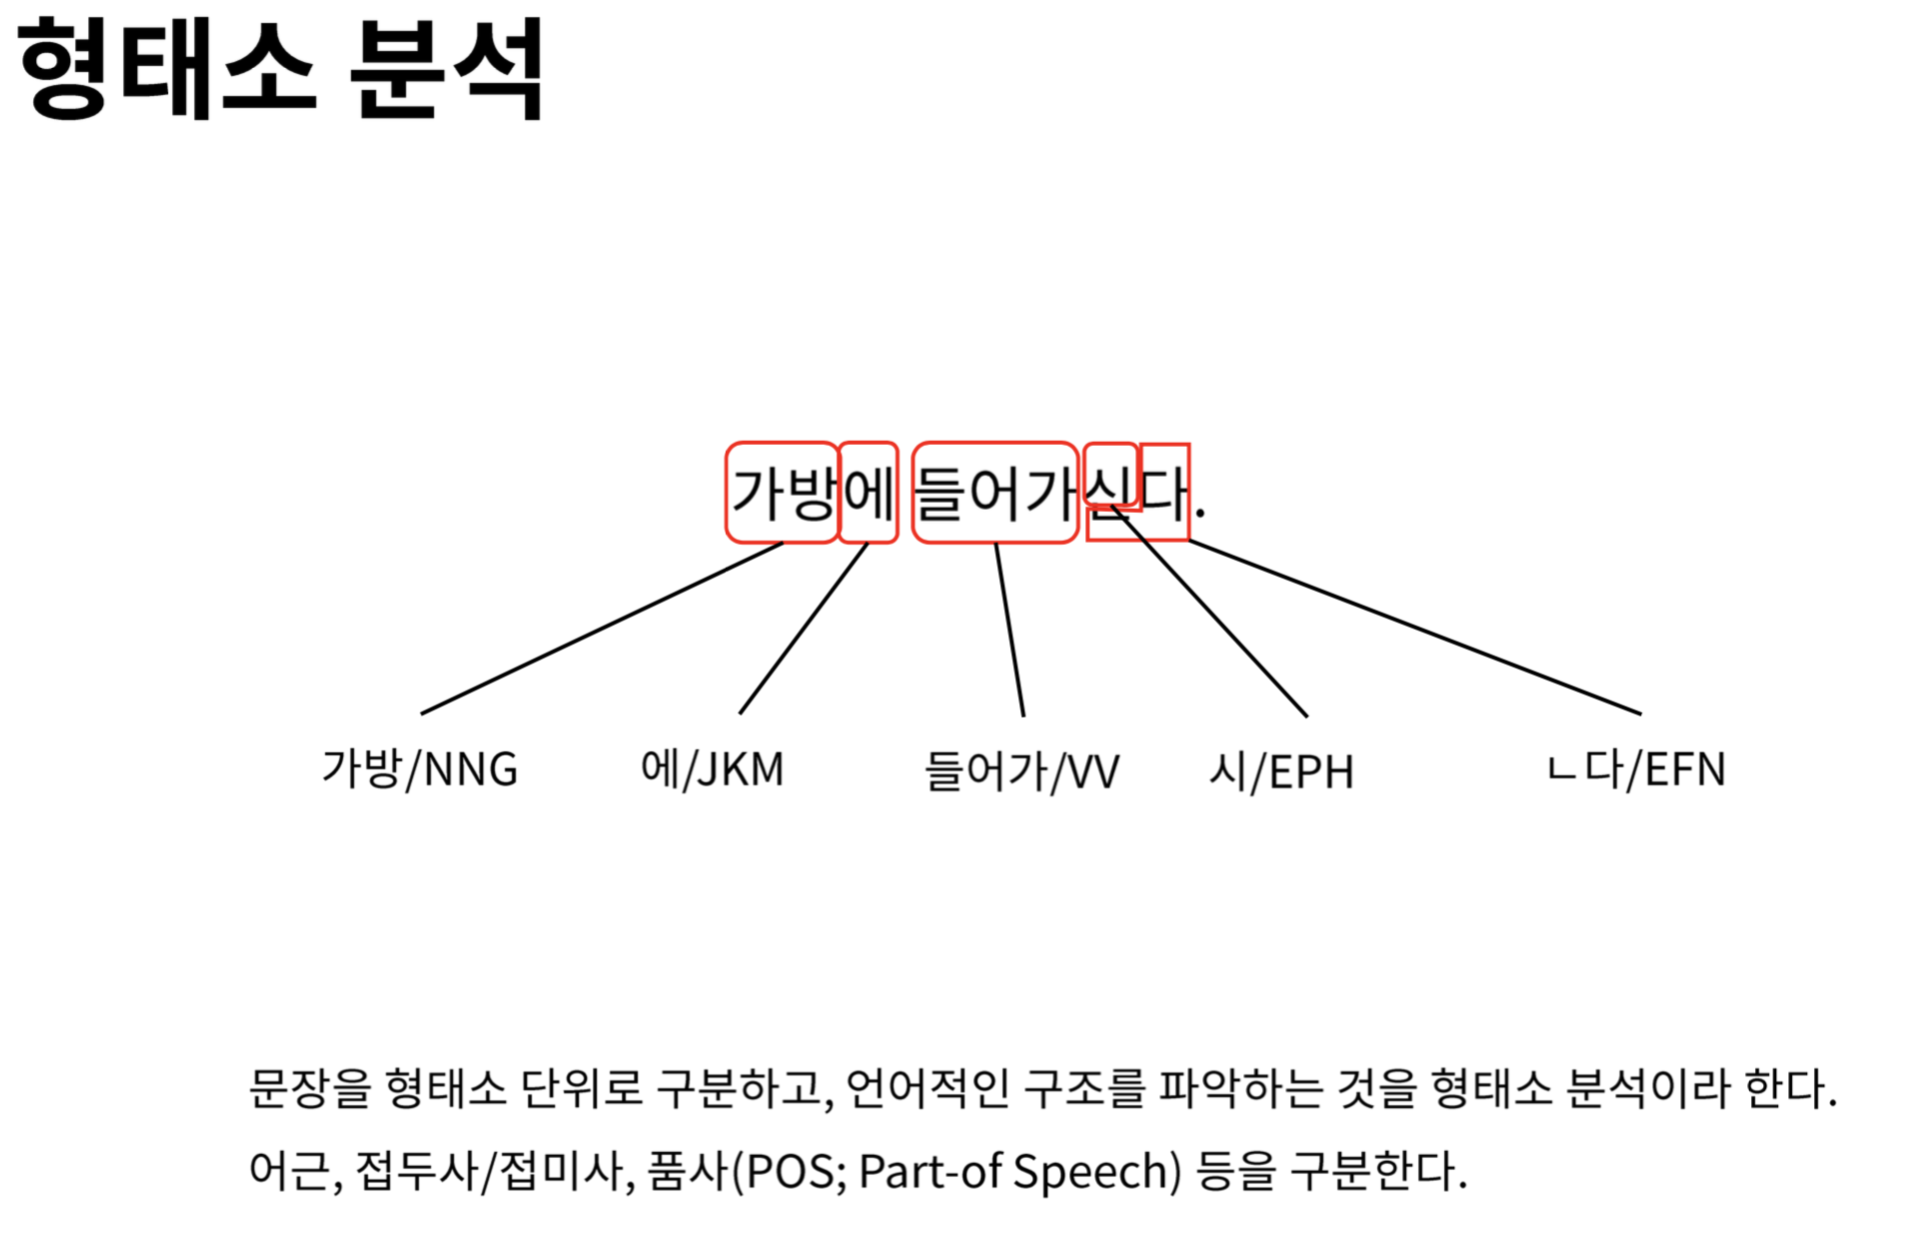
https://heung-bae-lee.github.io

Slide 4
NLP learning 을 위한 텍스트 엔코딩 ( encoding)
Label encoding
Bag of Word (BOW)
TF-IDF encoding
Word2Vec encoding
BERT encoding
End-to-End approach (word embedding layer)
https://medium.com/analytics-vidhya/nlp-text-encoding-a-beginners-guide-fa332d715854

Slide 5
Label encoding 예
텍스트 : [“this is a good phone” , “this is a bad mobile” , “she is a good cat” , “he has a bad temper” , “this mobile phone is not good”]
Data Corpus : [“a” , “bad” , “cat” , “good” , “has” , “he” , “is” , “mobile” , “not” , “phone” , “she” , “temper” , “this”]
Label encoding : [a : 1, bad : 2, …, this : 13]
encoded 텍스트: [13 7 1 4 10] , [13 7 1 2 8] , [11 7 1 4 3] , [6 5 1 2 12] , [13 8 10 7 9 4]
https://medium.com/analytics-vidhya/nlp-text-encoding-a-beginners-guide-fa332d715854

Slide 6
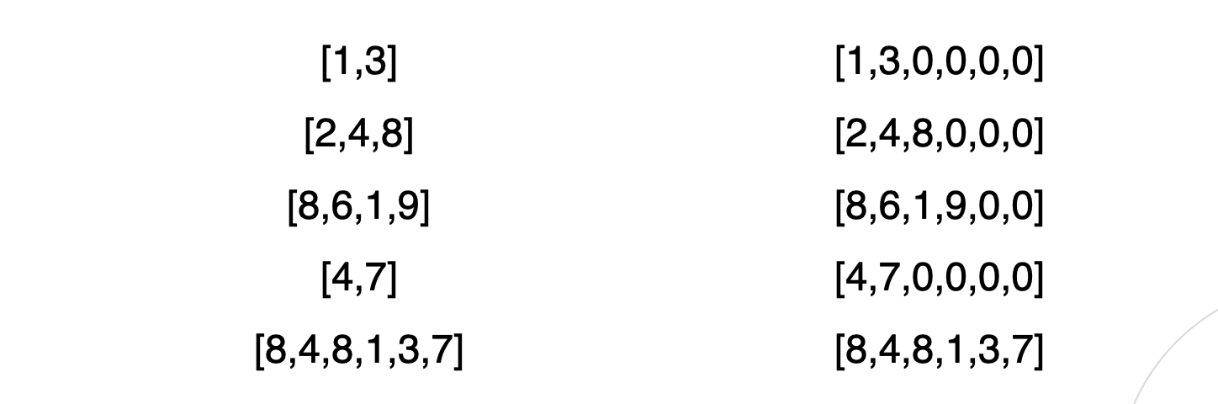
제로 패딩 (Zero padding)
https://velog.io/@dltpdl31/

Slide 7
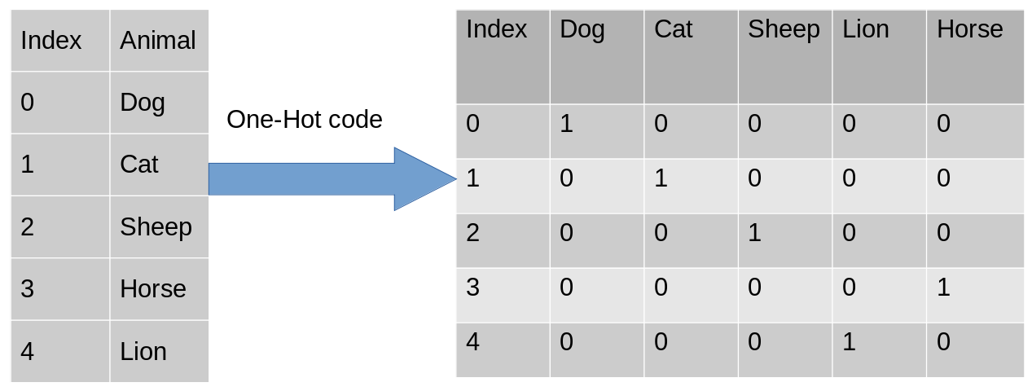
Label encoding to One-hot encoding

Slide 8
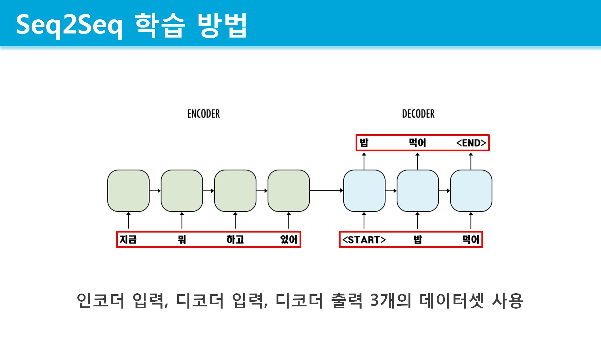
https://github.com/deepseasw/seq2seq_chatbot/

Slide 9
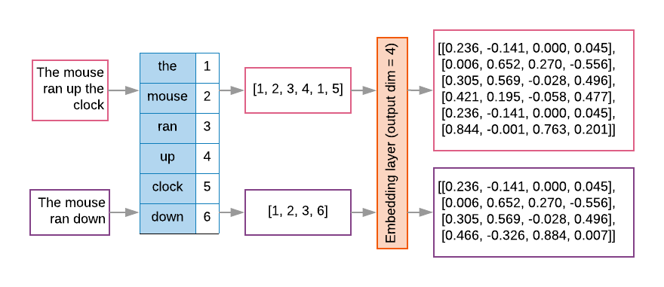
Embedding layer
https://towardsdatascience.com/pre-trained-word-embedding-for-text-classification-end2end-approach

Slide 10
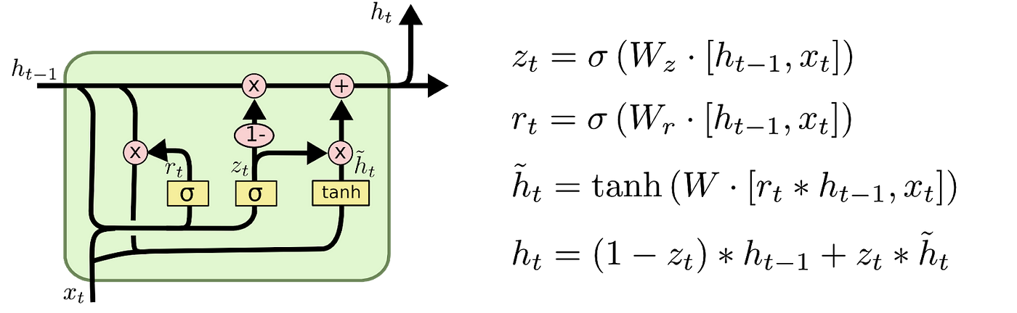
GRU cell

Slide 11
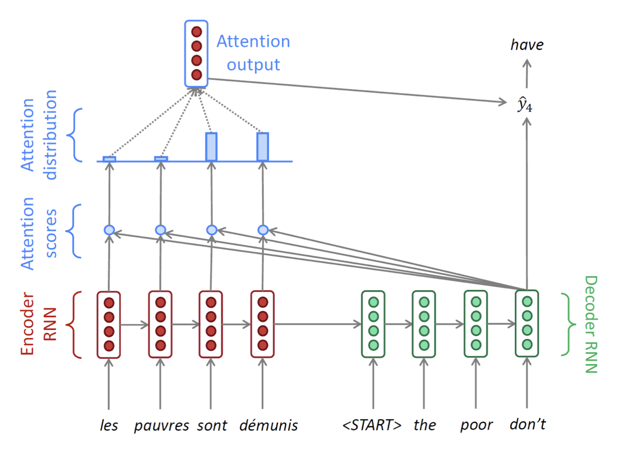
seq2seq
with attention

Slide 12
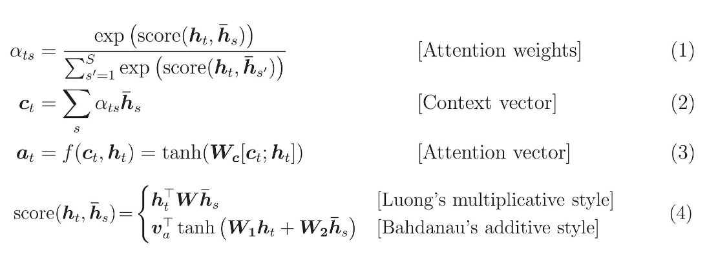
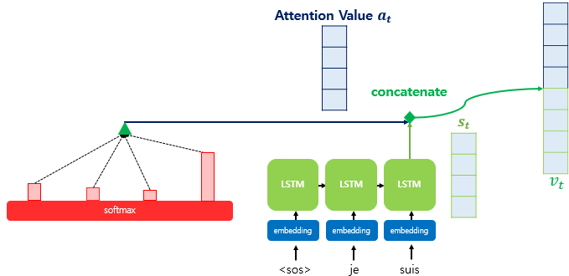
Bahdanau’s attention

